Slide 1

Team 03
AI DRIVEN REVENUE ANALYSIS
FOR HOTELS
1

Slide 2


Team Members
Garv Jain
Hima Rose George
Nabamita Samui
Punna Gayathri
Rajshree Ghosh
Syed Anwar Rizvi
Under Guidance of
Mentor Mukilan Selvaraj
2

Slide 3

OVERVIEW
INTRODUCTION
PROJECT OVERVIEW
MILESTONES
DASHBOARD DEVELOPMENT
DASHBOARD SNAPSHOTS
INSIGHTS & FINDINGS
CONCLUSION
3

Slide 4


INTRODUCTION
The objective is to give hotels real-time visibility into revenue drivers using modern BI and strong data models.
The platform tracks Occupancy %, ADR, RevPAR, and guest segmentation, enabling branch-wise comparisons and forecasting of occupancy and revenue from historical data.
By visualizing booking patterns and demographics, managers can find upselling opportunities, run targeted marketing, and adjust seasonal and room-type pricing for profitability.
The solution scales across hotel chains and geographies, helping management make faster, smarter decisions with reliable insights.
4

Slide 5

PROJECT OVERVIEW
KEY FEATURES
Tracks occupancy, guest demographics, and pricing performance
KPI dashboards: Occupancy %, ADR, RevPAR, seasonal trends
Guest segmentation, forecasting, and cancellation analysis
Strategic insights for pricing, promotions, and upselling
Traveler personas: business, family, solo, first-timers, loyal, high spenders
Visuals on nationality, booking source, stay duration, loyalty & spend patterns
5

Slide 6

MILESTONE 1
Cleaned & transformed booking, customer, and room data
Designed star schema with Fact & Dimension tables for reporting
Ensured consistency for occupancy, revenue & guest dashboards
MILESTONE 4
Built forecasting module for occupancy trends using historical booking data
Analyzed cancellation behavior with lead time distributions & no-show patterns
Designed visualizations: occupancy trend lines, cancellation heatmap, refund bar charts
Enabled managers to anticipate demand and mitigate revenue loss from cancellations
MILESTONE 2
Built dynamic Power BI dashboard for KPIs (Occupancy %, ADR, RevPAR)
Added interactive filters: room type, location, booking source
Enabled managers to drill into segment-specific insights
MILESTONE 5
MILESTONE 3
Developed revenue strategy dashboard for pricing & upselling opportunities
Integrated upsell potential estimation (ancillary services, dining, packages)
Implemented seasonal pricing tiers by room type & booking channel
Added recommendation visuals for managers to optimize promotions & offers
Guest segmentation by purpose, demographics & loyalty
(Business, Leisure, Groups, Repeat)
Persona insights connect profiles with ADR, Occupancy & RevPAR
Supports optimized pricing, promotions & loyalty strategies
6

Slide 7
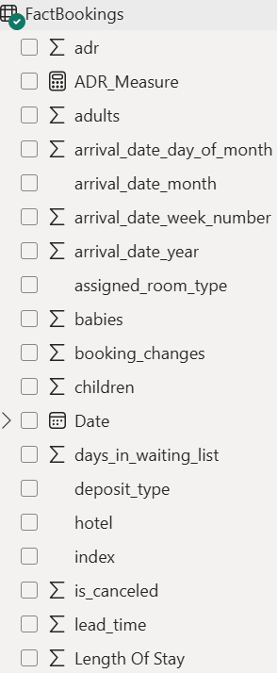
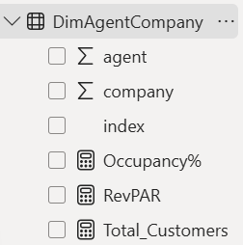
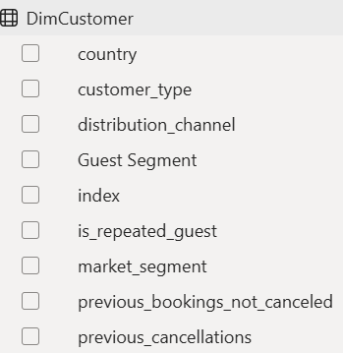
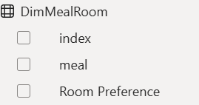
DATASET OVERVIEW
Key Information:
Source: Booking data from a city hotel and a resort hotel.
Timeframe: July 2015 to August 2017.
Record Count: Approximately 119,390 hotel bookings.
Key Goal: Understand hotel booking trends, guest behavior, and factors influencing booking cancellations.
Core Data Points:
7

Slide 8


POWER BI DATA PREPARATION & TRANSFORMATION
Introduced Key Metrics:
Merged Columns:
Consolidated three separate date columns (arrival_date_year,arrival_date_month, arrival_date_day_of_month) into a single, unified arrival_date column for efficient time-series analysis.
A custom column was added to calculate the total length of a guest's stay (total_stay_nights) by summing the stays_in_weekend_nights and stays_in_week_nights columns. This created a new metric for deeper analysis.
Handled Missing Values:
Corrected Data Types:
Addressed missing data in the country column and arrival_date_month and market_segment and distribution_channel by replacing all empty values to prevent errors and ensure all records are represented in the analysis.
Identified and corrected incorrect data types for all numerical columns, including lead_time, stays_in_weekend_nights, adults, and adr. This ensured that the values could be used for accurate calculations and summaries.
8

Slide 9

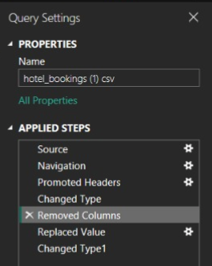
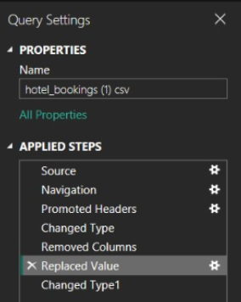
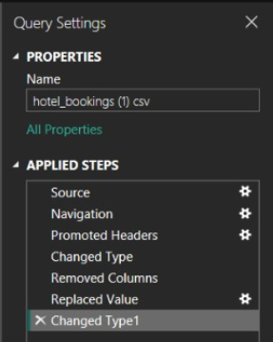
POWER BI SCREENSHOTS
REMOVED COLUMNS
REPLACED NULLS
TRANSFORM COLUMN TYPES
9

Slide 10

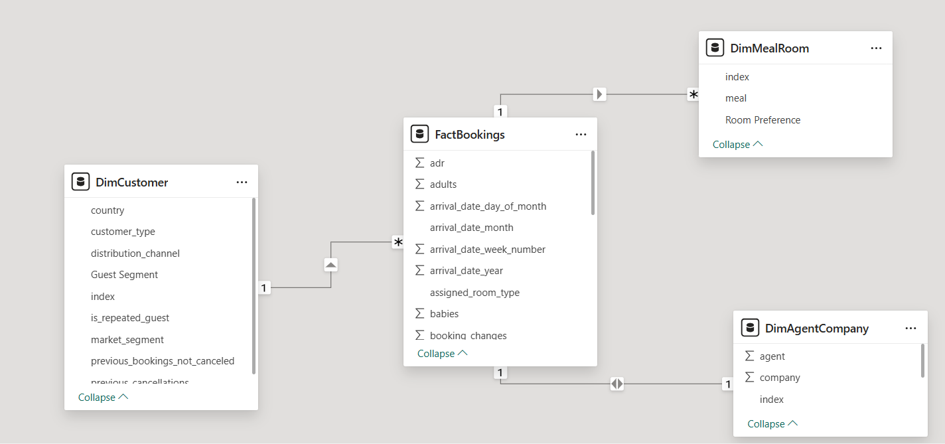
STAR SCHEMA & RELATIONSHIPS
FACTBOOKINGS → DIMCUSTOMER
RELATIONSHIP: 1-TO-MANY (ONE CUSTOMER CAN MAKE MANY BOOKINGS).
CONNECTION VIA INDEX (CUSTOMERID).
FACTBOOKINGS → DIMMEALROOM
RELATIONSHIP: 1-TO-MANY (ONE MEAL/ROOM TYPE CAN APPEAR IN MANY BOOKINGS).
CONNECTION VIA MEAL / ASSIGNED_ROOM_TYPE.
FACTBOOKINGS → DIMAGENTCOMPANY
RELATIONSHIP: 1-TO-MANY (ONE AGENT/COMPANY CAN HANDLE MANY BOOKINGS).
CONNECTION VIA AGENT / COMPANY.
10

Slide 11
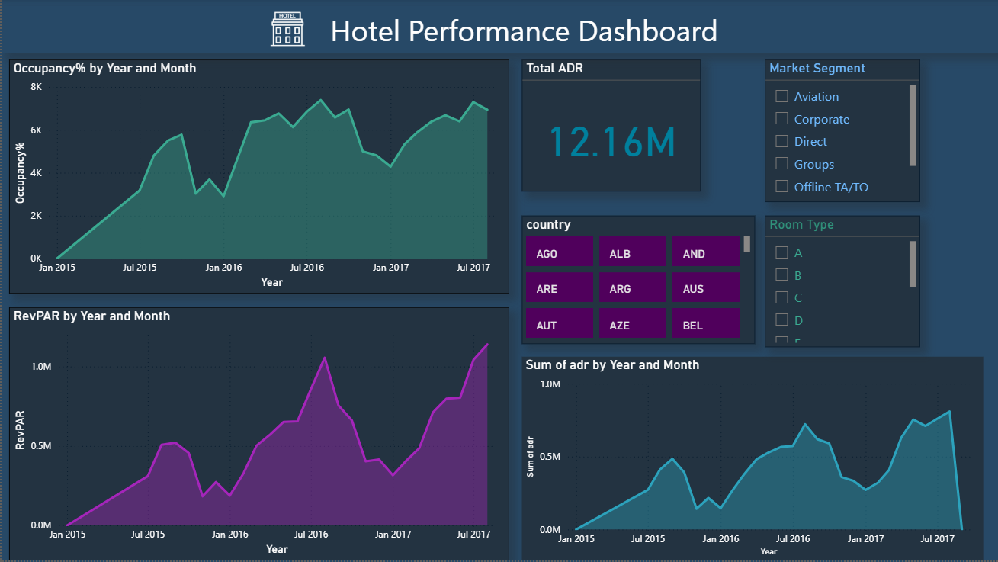
INTERACTIVE DASHBOARDS
11

Slide 12
OCCUPANCY & REVENUE PERFORMANCE ANALYSIS
Occupancy % Over Time
Tracks monthly/annual demand with seasonal peaks.
Guides staffing, inventory, and promotional planning.
Revenue Performance
ADR: Revenue per occupied room (pricing measure).
RevPAR: Combines ADR + occupancy (overall revenue).
Shows steady growth with dips in low-demand periods.
12

Slide 13
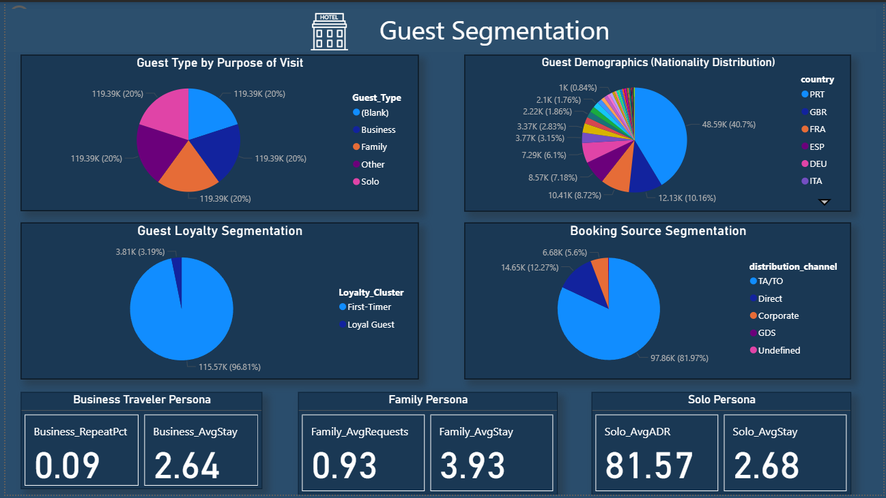
INTERACTIVE DASHBOARD
13

Slide 14

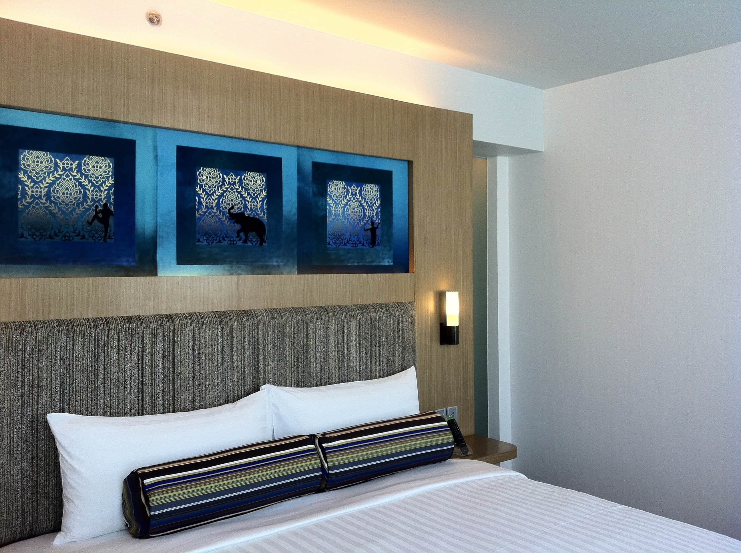
GUEST ANALYSIS MODE
Implemented detailed guest segmentation to understand behavior and preferences.
Categorized guests by purpose of visit: Business, Family, Solo.
Added guest demographics analysis: nationality distribution.
Built booking source segmentation (Direct, OTA, Corporate, GDS).
Introduced loyalty module: First-timers, Loyal Guests, High Spenders.
Designed customer personas with KPIs: Avg Stay, Repeat %, ADR.
14

Slide 15
INTERACTIVE FILTERING
One of the key features of this dashboard is its interactive filtering system.
Filter by guest type (Business, Family, Solo, Other) to compare behaviors.
Analyze nationality-based performance for regional insights.
Explore loyalty patterns: First-Timers vs. Loyal Guests.
Review booking channels (TA/TO, Direct, Corporate, GDS) to assess revenue sources.
15

Slide 16
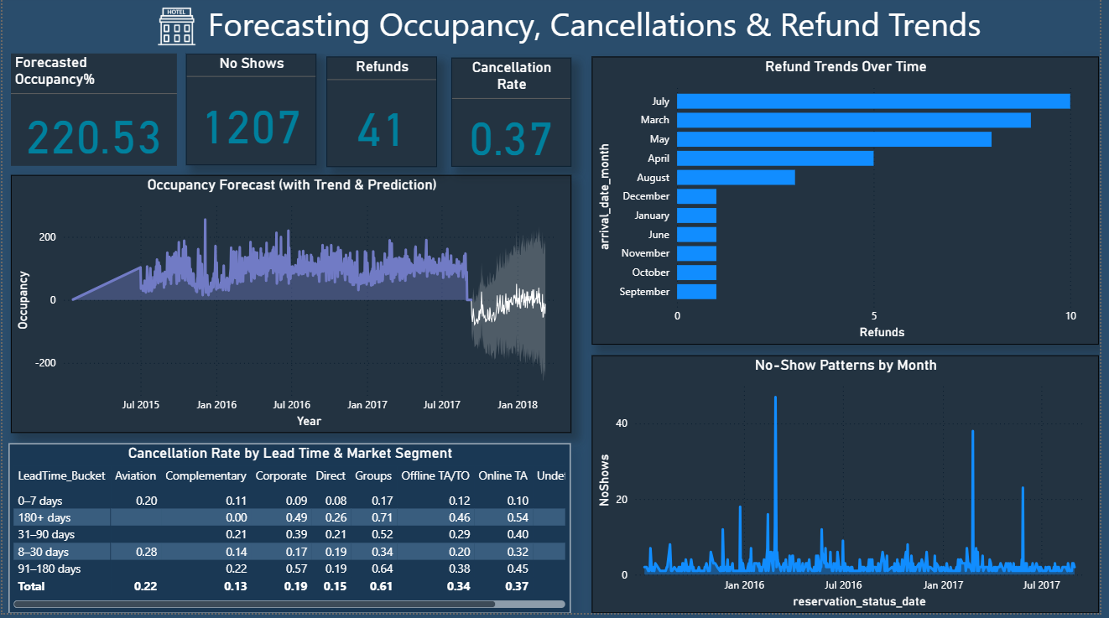
INTERACTIVE DASHBOARDS
16

Slide 17
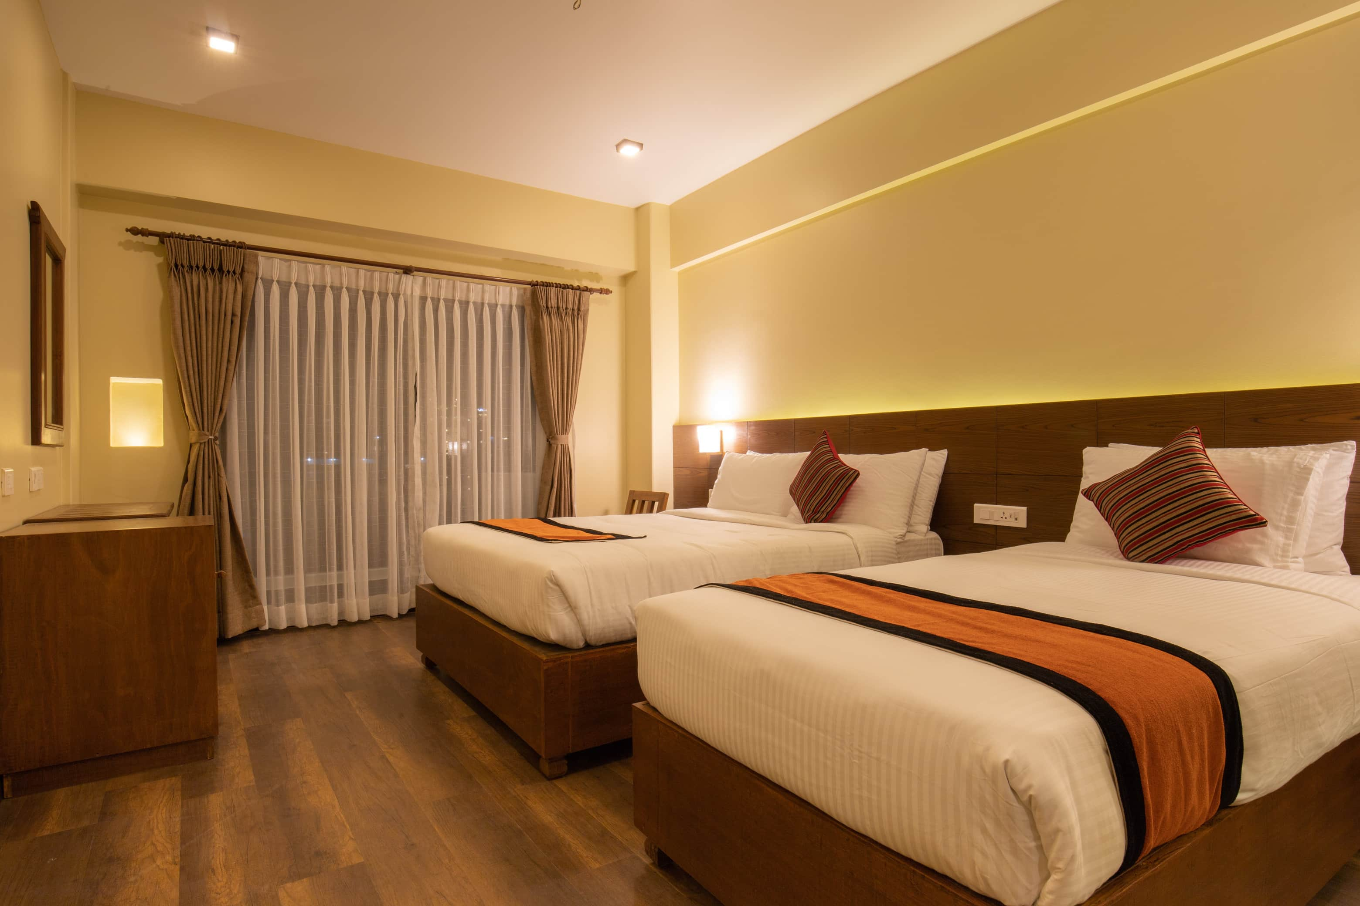

FORECASTING OCCUPANCY, CANCELLATIONS & REFUND TRENDS
Built an analytics dashboard providing real-time visibility into forecasted occupancy, cancellation rates, and refund trends.
Forecasted occupancy shown through historical and prediction graphs, enabling managers to anticipate demand fluctuations.
Cancellation rates analyzed by lead time and market segment, supporting precise policy adjustments and risk reduction.
Refund trends tracked monthly, revealing periods of heightened risk and supporting proactive revenue protection.
Detailed no-show patterns visualized, helping optimize booking conditions and resource planning.
Delivers actionable insights for improving hotel revenue management, operational preparedness, and guest satisfaction
17

Slide 18
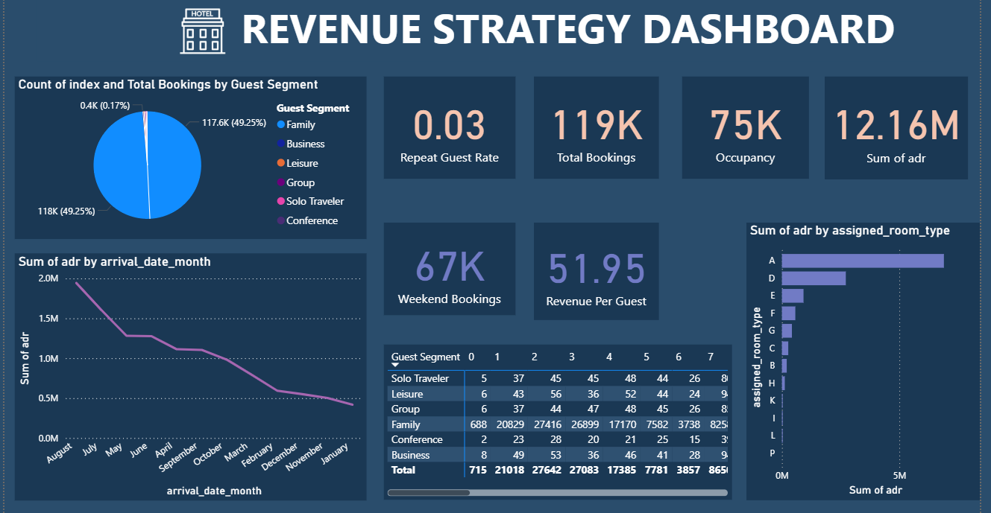
INTERACTIVE DASHBOARD
18

Slide 19

REVENUE STRATEGY
Built a comprehensive dashboard offering a unified view of key revenue metrics—ADR (12.16M), total bookings (119K), occupancy (75K), and revenue per guest (51.95).
Segmented guest booking patterns and total bookings by business, leisure, solo, family, group, and conference segments, spotlighting major revenue drivers.
Analyzed potential upsell revenue (401.40) and identified 979 upsell candidates, enabling managers to create targeted packages and optimize ancillary income.
Tracked ARR and repeat guest rate, enabling pricing strategies by season and guest type to maximize high-value bookings.
Provided actionable insights to tailor promotions, strengthen guest retention, and drive overall profitability through data-driven decision-making and personalized marketing.
19

Slide 20
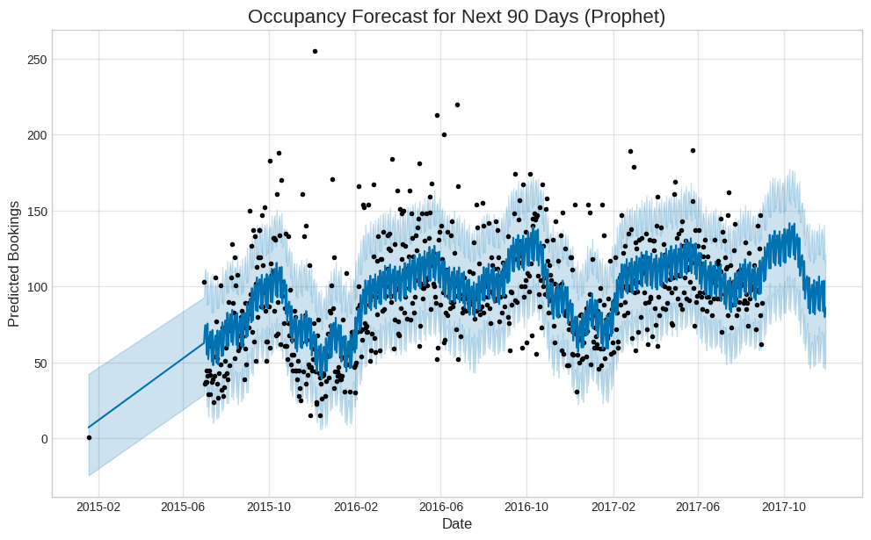
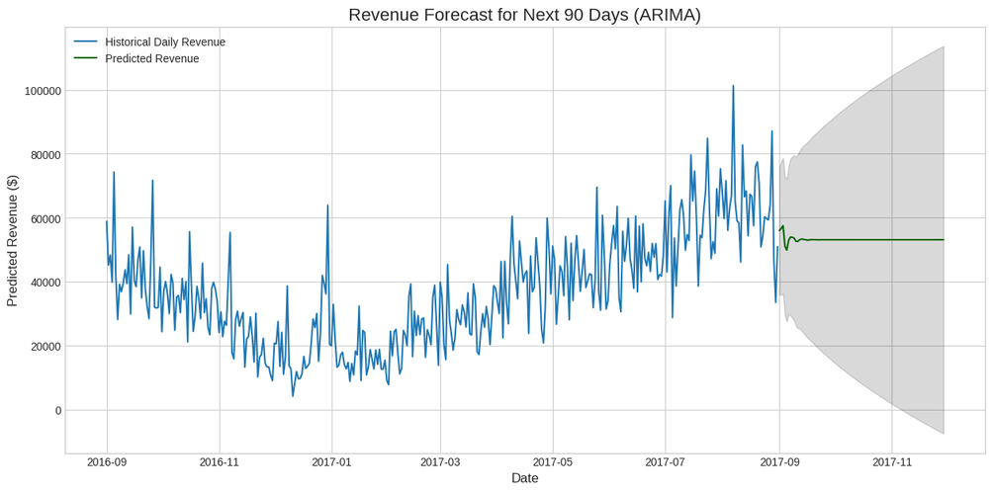
AI-DRIVEN FORECASTING: OPTIMIZING FUTURE HOTEL PERFORMANCE
Goal: Shift from reactive reporting to proactive decision-making using predictive AI.
Occupancy & Revenue Forecast (Prophet & ARIMA):
90-Day Projection: Forecasts 10,254 total bookings and $4,789,181.45 revenue.
Action: Directly informs Yield Management (setting higher rates during peak times) and precise staff scheduling.
Cancellation Risk Mitigation (Random Forest):
High-Risk ID: Identifies [4886 bookings (13.6% of the total)] bookings
with a ≥75% cancellation probability.
Action: Target these 4886 bookings with a proactive engagement
campaign to mitigate revenue loss
20

Slide 21

The Final Deliverable: Interactive Strategy Tool
Solution: All predictive models are integrated into a user-friendly Streamlit Dashboard.
Key Features for Management:
Adjustable Forecast: Management can instantly change the number of forecast days (e.g., 30, 90, 365) to test different horizons.
Dynamic Risk List: The dashboard provides the exact list of high-risk bookings (date, ADR, customer type) for immediate follow-up.
Model Performance: Transparency via a live display of the Random Forest model's performance metrics.
Strategic Recommendation: Immediately implement a three-part strategy:
Automate pricing based on the Revenue Forecast.
Proactively staff based on the Occupancy Forecast.
Target and retain high-risk guests identified by the Cancellation Model.
21

Slide 22

BUSINESS IMPACT
Revenue Optimization: ARIMA's Revenue Forecast enables dynamic, smarter pricing against forecasted demand, significantly boosting hotel profitability (RevPAR/ADR).
Operational Efficiency: Prophet's Occupancy Forecast ensures accurate staffing, while the Cancellation Model reduces costly overbooking and refunds.
Customer Retention: Enhanced loyalty analysis and Cancellation Risk Identification allow for proactive outreach to high-value or high-risk guests, improving retention.
Targeted Marketing: Use guest segmentation and risk profile to create tailored promotions (e.g., offer free services to high-risk bookings to secure them).
Distribution Strategy: Channel analysis (OTA vs. Direct) guides negotiations and helps shift focus to increase direct bookings.
Data-Driven Decisions: Managers make quick, evidence-based decisions using the unified dashboard, replacing time-consuming manual report generation.
Scalability & Consistency: The predictive models and dashboard framework can be scaled across all hotel branches for chain-wide, consistent performance monitoring.
22

Slide 23

CONCLUSION
Cleaned and transformed raw booking, customer, and room data to ensure accuracy, consistency, and reliability.
Designed a star schema model with Fact and Dimension tables, establishing correct relationships between customers, bookings, and hotel branches.
Created a well-structured dataset that serves as a foundation for performance analysis and reporting.
Developed interactive and dynamic dashboards to visualize key hotel metrics: Occupancy Percentage, Average Daily Rate (ADR), and Revenue per Available Room (RevPAR).
Implemented advanced filters for room type, location, booking source, and time period, enabling flexible and in-depth analysis.
Provided actionable, customizable insights to help monitor performance trends, optimize hotel operations, and support data-driven decision-making.
.
23

Slide 24
Thank You.
24

